Slide 1

K-Means Clustering

Slide 2
K-Means Clustering
This is the most commonly used unsupervised learning algorithm for portioning a given data set into a set of k groups (clusters).
Grouping is done such that objects in the same group are as similar as possible.
In k-means clustering, each cluster is represented by its center.

Slide 3
K-Means Clustering
The basic idea behind k-means clustering consists of defining clusters so that the total intra-cluster variation (total variation within-cluster) is minimized.
The standard algorithm is the Hartigan-Wong algorithm (1979), which defines the total within-cluster variation as the sum of squared Euclidean distances between items and the corresponding centroid:

Slide 4
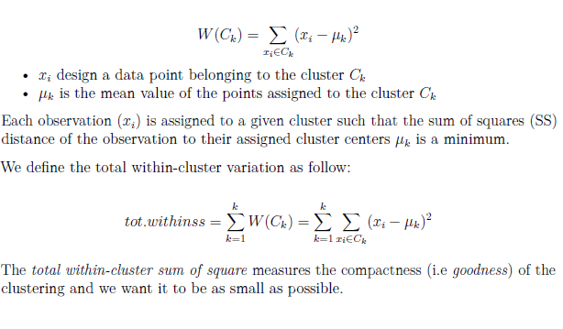
K-Means Clustering

Slide 5
K-means algorithm
1. Specify the number of clusters (K) to be created (by the analyst)
2. Select randomly k objects from the data set as the initial cluster centers or means
3. Assigns each observation to their closest centroid, based on the Euclidean distance between the object and the centroid

Slide 6
K-means algorithm
4. For each of the k clusters update the cluster centroid by calculating the new mean values of all the data points in the cluster. The centroid of a k-th cluster is a vector of length p containing the means of all variables for the observations in the k-th cluster; p is the number of variables.

Slide 7
K-means algorithm
5. Iteratively minimize the total within sum of squares. That is, iterate steps 3 and 4 until the cluster assignments stop changing or the maximum number of iterations is reached. By default, the R software uses 10 as the default value for the maximum number of iterations.

Slide 8
K-means clustering disadvantages
1. It assumes prior knowledge of the data and requires the analyst to choose the appropriate number of cluster (k) in advance.
2. The final results obtained is sensitive to the initial random selection of cluster centers.

Slide 9
K-means clustering disadvantages
3. It’s sensitive to outliers.
4. If you rearrange your data, it’s very possible that you’ll get a different solution every time you change the ordering of your data.

Slide 10
Computing k-means clustering in R
R functions and packages:
The standard R function for k-means clustering is kmeans() [stats package]

Slide 11
Summary
K-means clustering can be used to classify observations into k groups, based on their similarity. Each group is represented by the mean value of points in the group, known as the cluster centroid.
K-means algorithm requires users to specify the number of cluster to generate. The R function kmeans() [stats package] can be used to compute k-means algorithm.

